Slide 1
Lecture 12
Requirements Modeling:
  Behavior Model
    Sequence Diagram
BSSE (Software Engineering-I) SZABIST-Islamabad

Slide 2
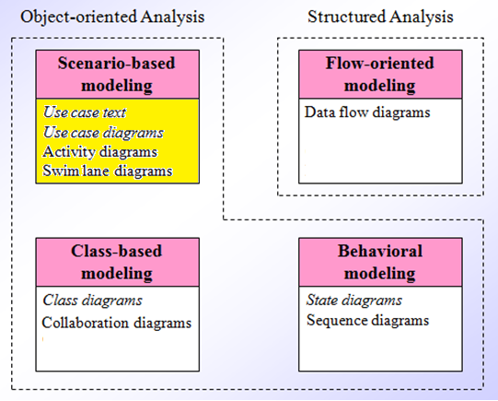
Requirement Analysis
BSSE (Software Engineering-I) SZABIST-Islamabad

Slide 3
Sequence Diagram
How object/actor in the system or classes with in code interact with each other through messages.
Sequences of events
A sequence diagram simply depicts interaction between objects in a sequential order i.e. the order in which these interactions take place.
Sequence diagrams describe how and in what order the objects in a system function.
Emphasize time ordering
System: all the parts that are involved in that system
Code: all the classes that make up program.

Slide 4
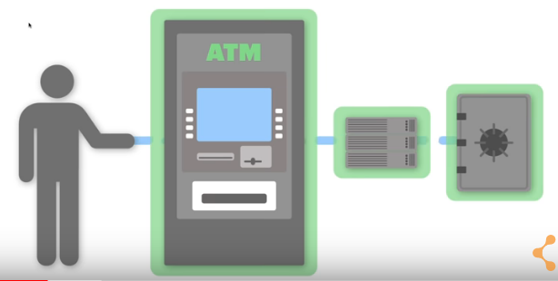
Parts involved in ATM Transaction
Person
ATM
Bank Server
Bank Account
BSSE (Software Engineering-I) SZABIST-Islamabad

Slide 5
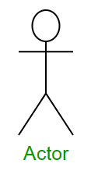
Sequence Diagram Notations
Actors – An actor in a UML diagram represents a type of role where it interacts with the system and its objects. It is important to note here that an actor is always outside the scope of the system we aim to model using the UML diagram.
We use actors to depict various roles including human users and other external subjects. We represent an actor in a UML diagram using a person notation. We can have multiple actors in a sequence diagram.

Slide 6
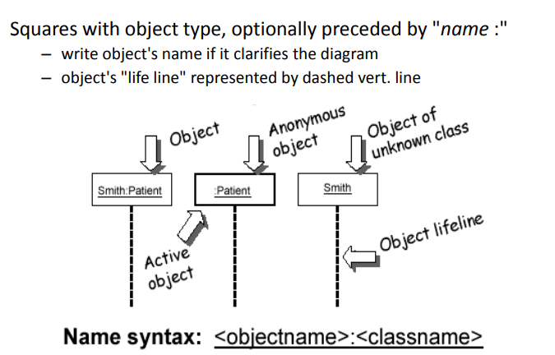

Sequence Diagram Notations
Objects – Objects are always inside the scope of the system. We represent the object by rectangle with its name and type.
The standard in UML for naming a object follows the following format – Instance Name : Class Name (if we are making sequence diagram of code)

Slide 7
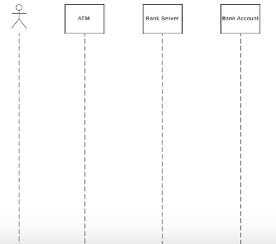
Sequence Diagram Notations
Lifelines – Life line are vertical dashed line that shows the existence of actor/object over time. Moving down the lifeline mean more time is passing. Interaction between lifelines happened using messages.

Slide 8
Difference between a Object and an actor?
An Object always portrays an object internal to the system whereas actors are used to depict objects external to the system. The following is an example of a sequence diagram:

Slide 9
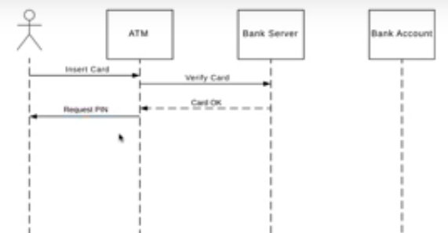
Messages
Messages – messages show the information being send between objects/actors. Sequence diagram shows the order of interaction or sequence and they do this by moving down the lifeline with each message. We represent messages using arrows. Object, Lifelines and messages form the core of a sequence diagram.
message
replay message

Slide 10
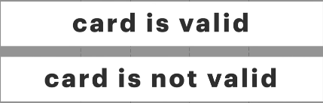
Alternative Frame
Alternative Frame symbolized choice between two or more message sequences. These choices are usually mutually exclusive.
Alternative
Positive Flow
[condition]
else
Negative Flow

Slide 11
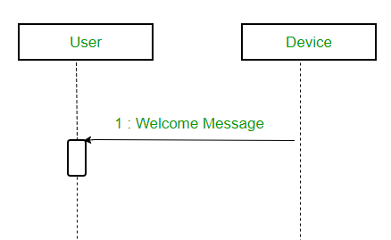
Activation Boxes
Activation Boxes show when and how long an object is performing a process this shows us at a glance when objects are active and when they are idle.
We represent activation boxes with small vertical rectangle over the dotted line.
BSSE (Software Engineering-I) SZABIST-Islamabad

Slide 12
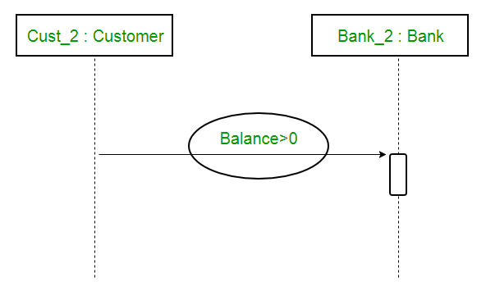
Guards
Guards – To model conditions we use guards in UML. They are used when we need to restrict the flow of messages on the pretext of a condition being met. Guards play an important role in letting software developers know the constraints attached to a system or a particular process.
For example: In order to be able to withdraw cash, having a balance greater than zero is a condition that must be met as shown below.

Slide 13
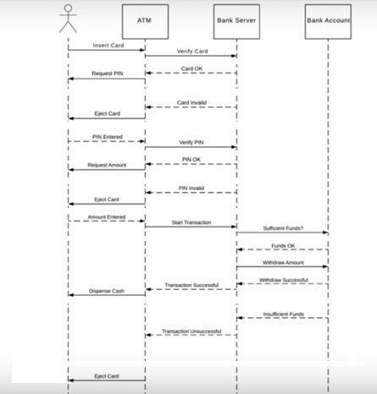
ATM Example
BSSE (Software Engineering-I) SZABIST-Islamabad

Slide 14
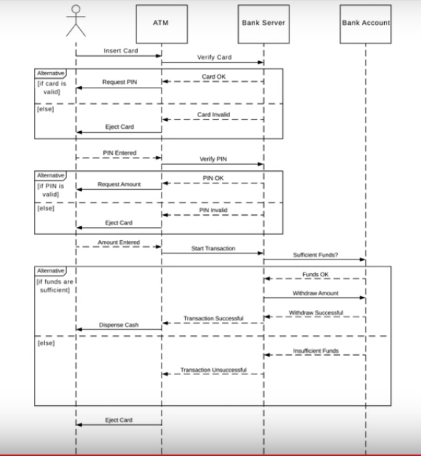
ATM Example
BSSE (Software Engineering-I) SZABIST-Islamabad

Slide 15
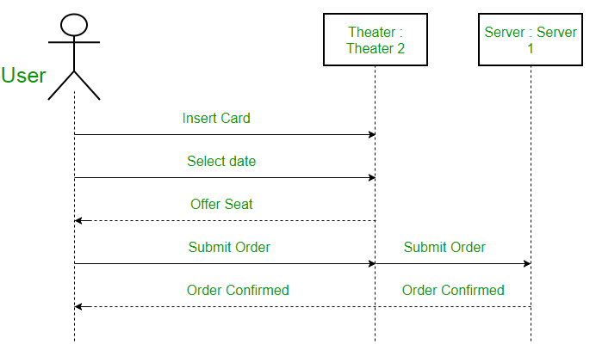
Sequence Diagram
For example – Here the user in seat reservation system is shown as an actor where it exists outside the system and is not a part of the system.

Slide 16
Different Types of Messages
Messages can be broadly classified into the following categories :
Synchronous Messages
Asynchronous Messages
Create Message
Delete Message
Self Message
Found Message
Lost Message

Slide 17
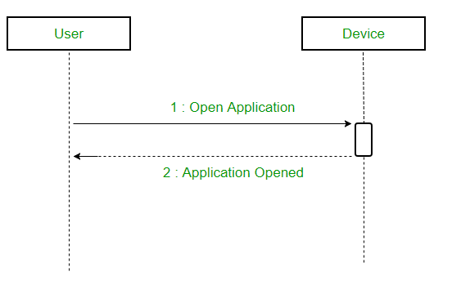
Synchronous Messages
Synchronous messages – A synchronous message waits for a reply before the interaction can move forward. The sender waits until the receiver has completed the processing of the message. The caller continues only when it knows that the receiver has processed the previous message i.e. it receives a reply message.

Slide 18
Asynchronous Messages
Asynchronous Messages – An asynchronous message does not wait for a reply from the receiver. The interaction moves forward irrespective of the receiver processing the previous message or not. We use a lined arrow head to represent an asynchronous message.

Slide 19
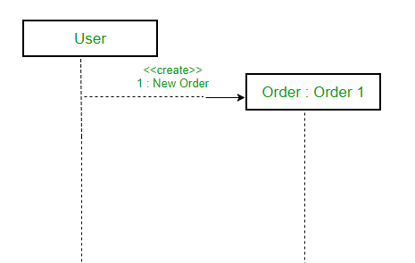
Create Messages
Create message – We use a Create message to instantiate a new object in the sequence diagram. There are situations when a particular message call requires the creation of an object. It is represented with a dotted arrow and create word labeled on it to specify that it is the create Message symbol.
For example – The creation of a new order on a e-commerce website would require a new object of Order class to be created.

Slide 20
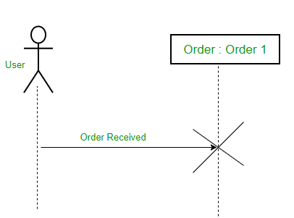
Delete Messages
Delete Message – We use a Delete Message to delete an object. When an object is deallocated memory or is destroyed within the system we use the Delete Message symbol. It destroys the occurrence of the object in the system. It is represented by an arrow terminating with a x.
For example – In the scenario below when the order is received by the user, the object of order class can be destroyed.

Slide 21
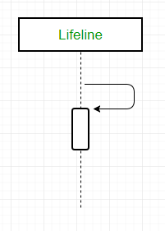
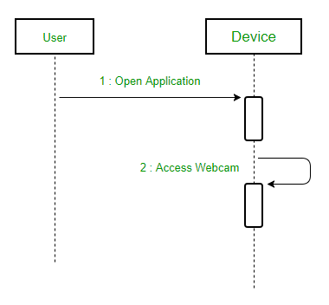
Self Messages
Self Message – Certain scenarios might arise where the object needs to send a message to itself. Such messages are called Self Messages and are represented with a U shaped arrow.
For example – Consider a scenario where the device wants to access its webcam. Such a scenario is represented using a self message.

Slide 22
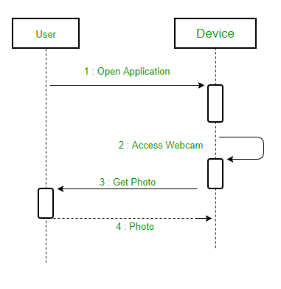

Reply Messages
Reply Message – Reply messages are used to show the message being sent from the receiver to the sender. We represent a return/reply message using an open arrowhead with a dotted line. The interaction moves forward only when a reply message is sent by the receiver.
For example – Consider the scenario where the device requests a photo from the user. Here the message which shows the photo being sent is a reply message.

Slide 23
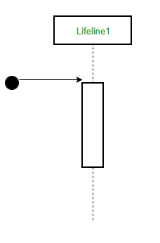
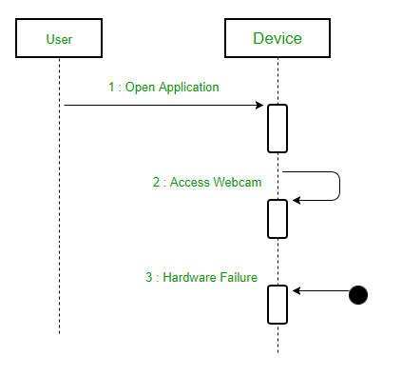
Found Messages
Found Message – A Found message is used to represent a scenario where an unknown source sends the message. It is represented using an arrow directed towards a lifeline from an end point. For example: Consider the scenario of a hardware failure.
It can be due to multiple reasons and we are not certain as to what caused the hardware failure.

Slide 24
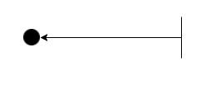
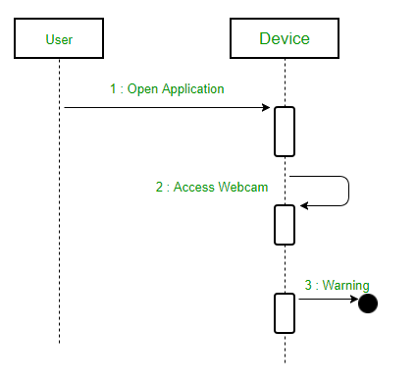
Lost Messages
Lost Message – A Lost message is used to represent a scenario where the recipient is not known to the system. It is represented using an arrow directed towards an end point from a lifeline. For example: Consider a scenario where a warning is generated.
The warning might be generated for the user or other software/object that the lifeline is interacting with. Since the destination is not known before hand, we use the Lost Message symbol. e.g. Log files

Slide 25
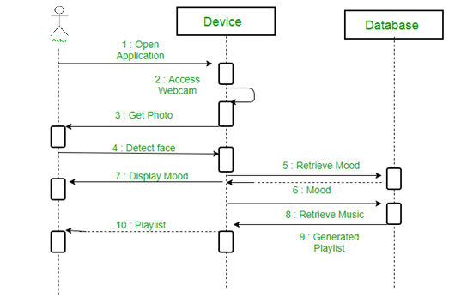
Example
A sequence diagram for an emotion based music player –

Slide 26
Example
A sequence diagram for an emotion based music player –
  The above sequence diagram depicts the sequence diagram for an emotion based music player:
  Firstly the application is opened by the user.
  The device then gets access to the web cam.
  The webcam captures the image of the user.
  The device uses algorithms to detect the face and predict the mood.
  It then requests database for dictionary of possible moods.
  The mood is retrieved from the database.
  The mood is displayed to the user.
  The music is requested from the database.
  The playlist is generated and finally shown to the user.

Slide 27
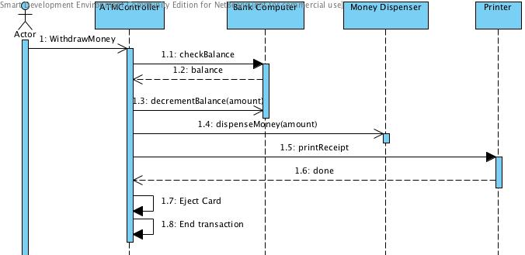
Example

Slide 28
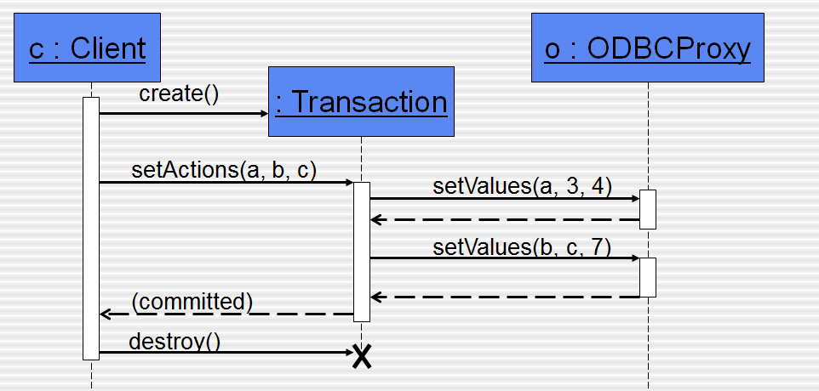
Example

Slide 29
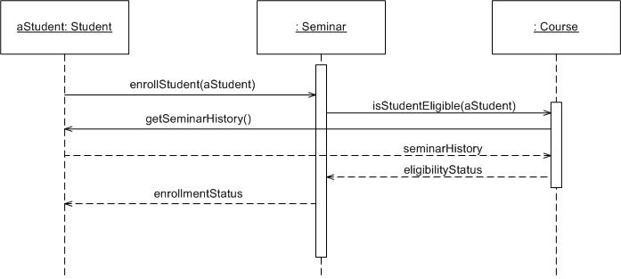
Example
Objects: aStudent is a specific instance of the Student class
Specific
Instance of an
Object
Generic
Instance of classes

Slide 30
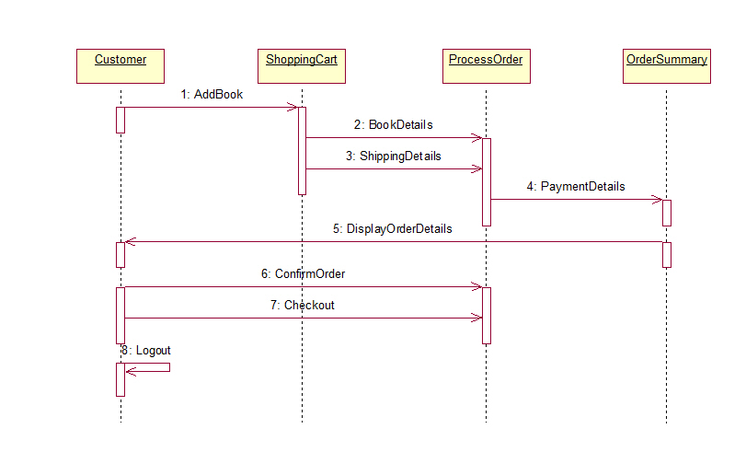
Example

Slide 31
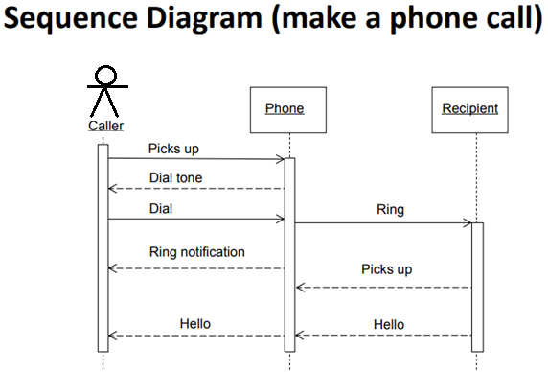
Example

